Slide 1
Facial Landmarks Detection with Synthetic Dataset
CMPT 732-G200 Project Presentation
Chaoyi Hu
Student # 301559775
Dec 12, 2022

Slide 2
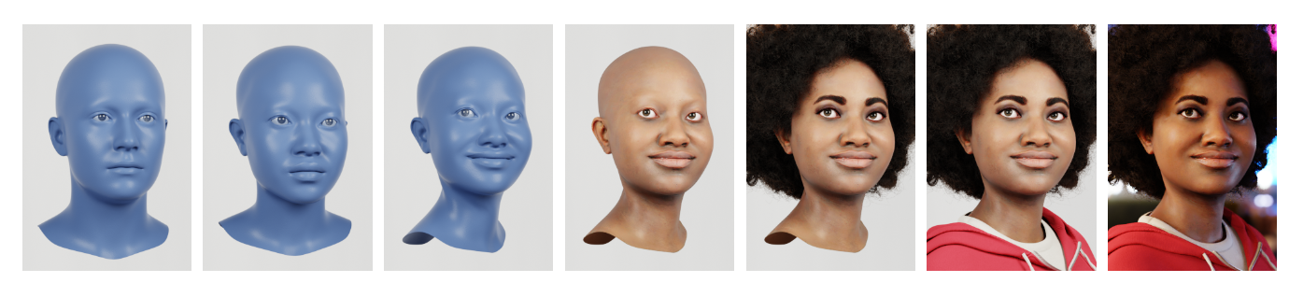
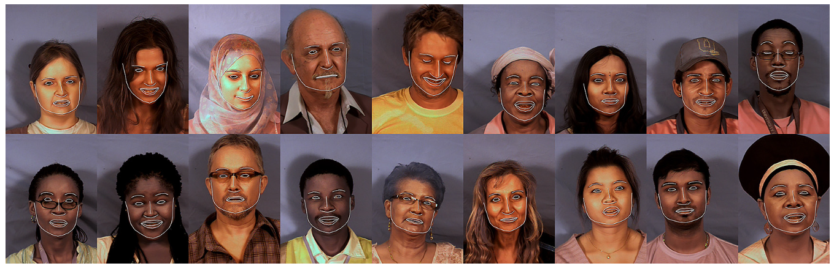
Background
Synthetic Facial Data
Controllable production
Accurate annotations
No ethical concerns
Other advantages
Demands for mobility
Lightweight: consumer devices
Fast: run in real time
Graph: https://microsoft.github.io/FaceSynthetics/

Slide 3
Problem Statement
Synthetic Facial Data
Controllable production
Accurate annotations
No ethical concerns
Other advantages
Demands for mobility
Lightweight: consumer devices
Fast: run in real time
Develop a Facial landmarks model that:
Trains on synthetic facial images
Evaluates on real facial images
Inference on consumer devices
In real time, FPS ≥ 30

Slide 4
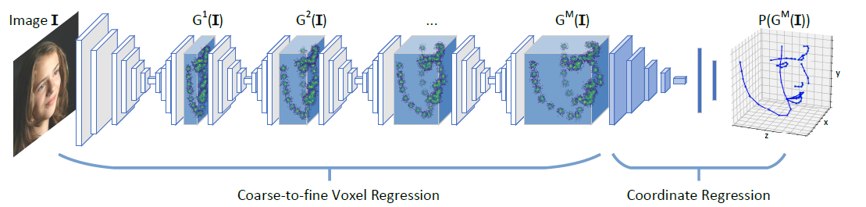
Inputs & Outputs
2D Human facial images
without depth information
3D facial landmarks positions
Graph: Zhang et al. 2018. Joint Voxel and Coordinate Regression for Accurate 3D Facial Landmark Localization.

Slide 5

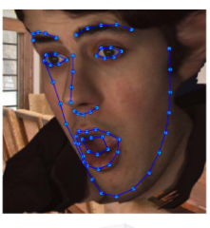
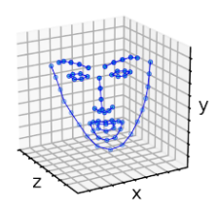
Inputs & Outputs
Expected final result: Application on consumer devices (desktop demo)
Takes human facial images cropped from video frames
Predicts and visualize 3D landmarks in real time at ≥ 30 FPS
Schematic figure

Slide 6
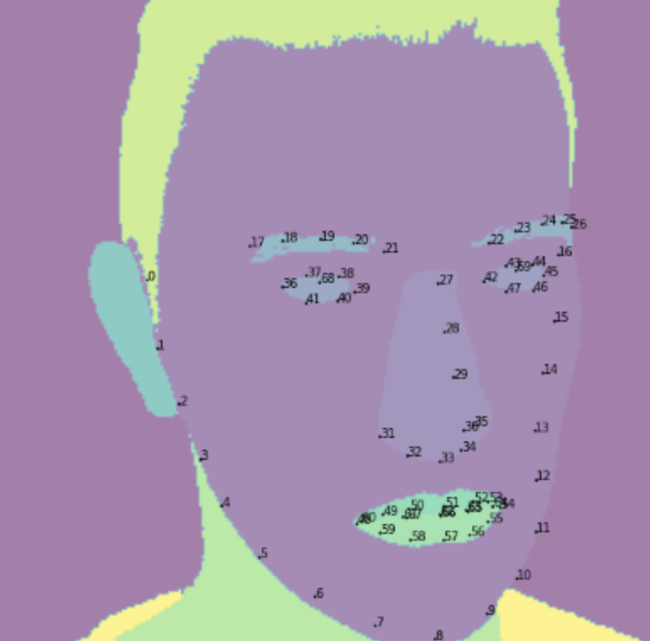
Datasets
Train & Validation
The Face Synthetics dataset
100,000 Synthetic 2D human facial images with 70-point 2D landmarks positions
Test
AFLW2000-3D
2000 Real-world 2D human facial images with image-level 68-point 3D facial landmarks annotations
https://github.com/microsoft/FaceSynthetics
http://www.cbsr.ia.ac.cn/users/xiangyuzhu/projects/3DDFA/main.htm
70-point: 2 extra points in the middle of L and R eye

Slide 7
Pipeline
Face Detection Module
(Obtain accurate face crop)
Landmarks Prediction Module
(Obtain landmark locations)
2D image
3D coordinates
Ref: https://arxiv.org/pdf/1801.09242.pdf
https://google.github.io/mediapipe/solutions/face_mesh.html

Slide 8
Pipeline Part 1
Face Detection Module
(Obtain accurate face crop)
Landmarks Prediction Module
(Obtain landmark locations)
2D image
3D coordinates
Ref: https://arxiv.org/pdf/1801.09242.pdf
https://google.github.io/mediapipe/solutions/face_mesh.html

Slide 9
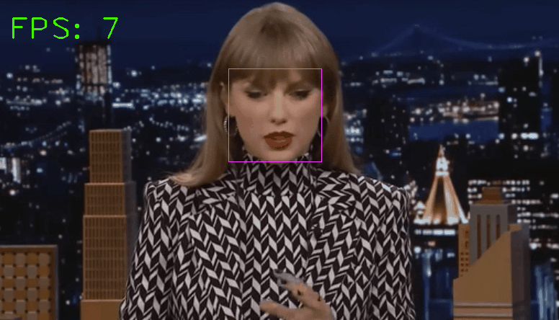
Facial Detection
Face detection module
Classic HOG feature combined with a linear classifier, an image pyramid, and sliding window detection scheme (dlib implementation)
Slow
Avg time for face Detection: 131.67 ms per frame
Avg processing rate: 7.29 FPS
http://dlib.net/face_detector.py.html

Slide 10
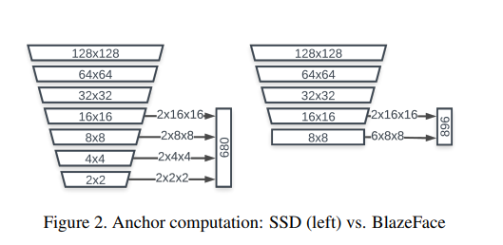
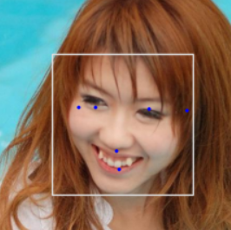
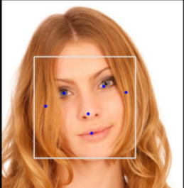
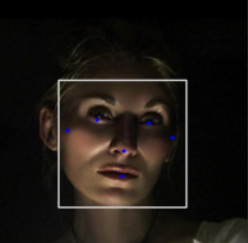
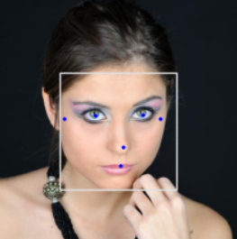
Facial Detection
Face detection module
Improved
BlazeFace (MediaPipe implementation, pre-trained)
Lightweight, Fast
BlazeFace detection tested on AFLW2000 data
https://google.github.io/mediapipe/solutions/face_detection.html
Graph: https://arxiv.org/abs/1907.05047

Slide 11
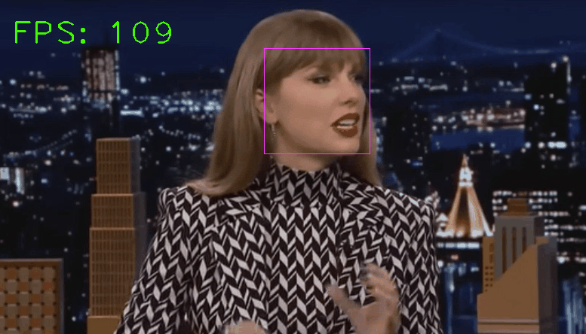
Facial Detection
Face detection module
Improved
BlazeFace (MediaPipe implementation, pre-trained)
Lightweight, Fast
Avg time for face Detection: 11.91 ms per frame
Avg processing rate: 83.35 FPS
https://google.github.io/mediapipe/solutions/face_detection.html

Slide 12
Pipeline Part 2
Face Detection Module
(Obtain accurate face crop)
Landmarks Prediction Module
(Obtain landmark locations)
2D image
3D coordinates
Ref: https://arxiv.org/pdf/1801.09242.pdf
https://google.github.io/mediapipe/solutions/face_mesh.html

Slide 13
Landmarks
Network Architecture
b×3×192×192
FaceMesh Block
=
Backbone
( )×14
Conv2D
( )×14
MaxPool2D
(if stride==2)
Conv2D
+
( )×3
PReLU
https://google.github.io/mediapipe/solutions/face_mesh.html#face-detection-model
https://github.com/thepowerfuldeez/facemesh.pytorch
b×1
b×68×3
Confidence (face being present)
Coordinates (3D 68-points)

Slide 14
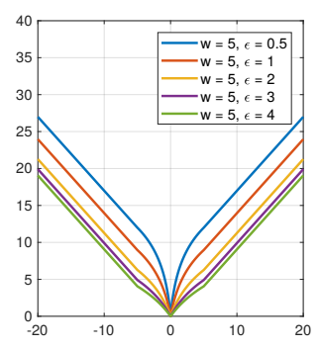
Landmarks
Implementation
Implementation
Added BatchNorm layers (after Conv2D in FaceMesh Block)
Optimizer: Adam
Wing Loss (w=5, curvature=0.5)
PyTorch
https://arxiv.org/pdf/1711.06753.pdf

Slide 15
Landmarks
100% Real
4000 images
~150 epochs
batch_size = 8
lr=10e-4 -> 10e-6
Optimizer: Adam, weight decay=0.0005
Trained on Matpool
GPU Name: NVIDIA Tesla K80
Training time: ~10h
Model size: 1.2M

Slide 16
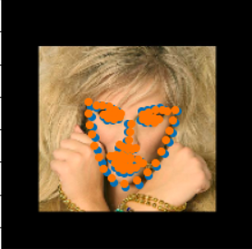
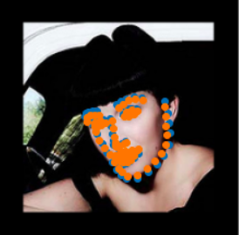
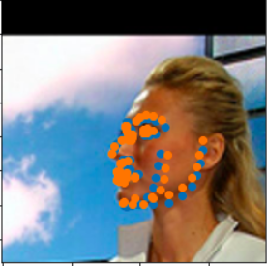
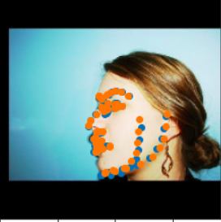

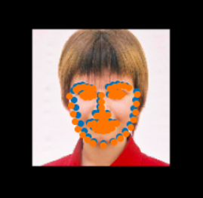
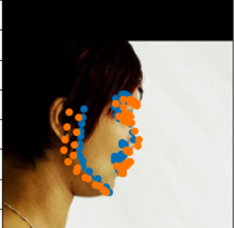

Train: 100% Real
Test: Real
Landmarks - Results
Front
Posture

Slide 17
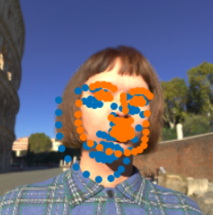
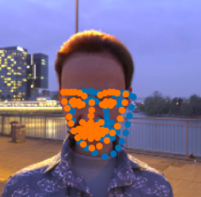
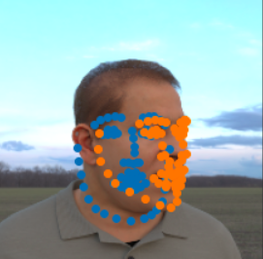
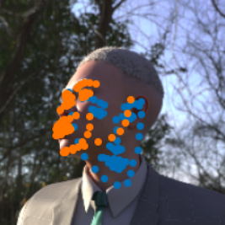
Train: 100% Real
Test: Synthetic
Landmarks - Results
Front
Posture

Slide 18
Landmarks
100% Synthetic
2000 images
~200 epochs
batch_size = 10 -> 4
lr=10e-4 -> 10e-6
Optimizer: Adam, weight decay=0.0005
Trained on Matpool
GPU: NVIDIA Tesla K80
Training time: ~6h
Model size: 1.2M

Slide 19
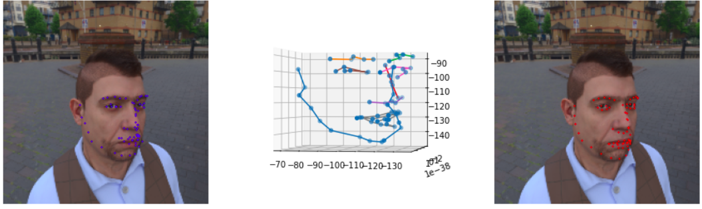
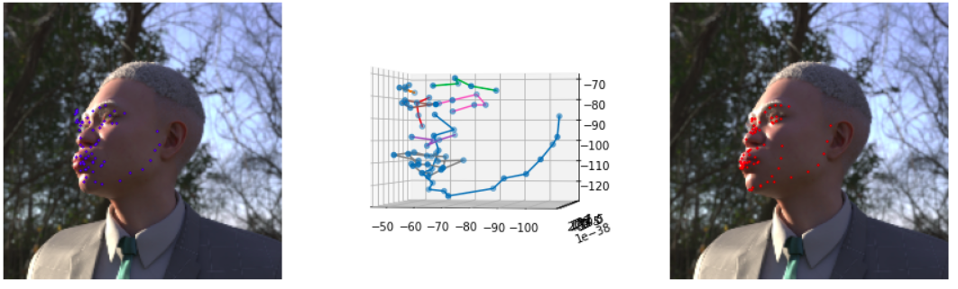
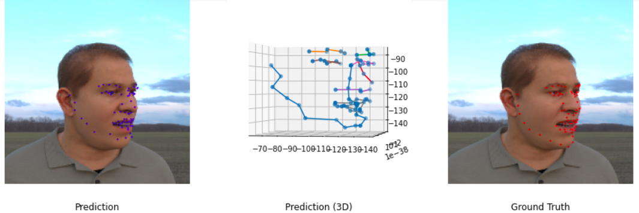
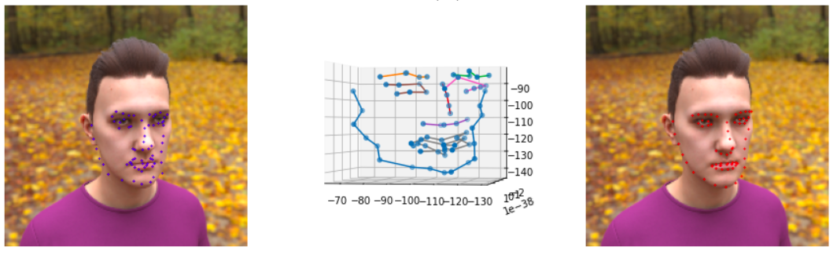
Train: 100% Synthetic
Test: Synthetic
Landmarks - Results

Slide 20

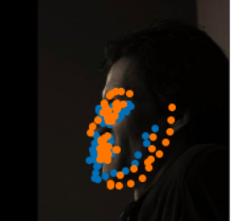
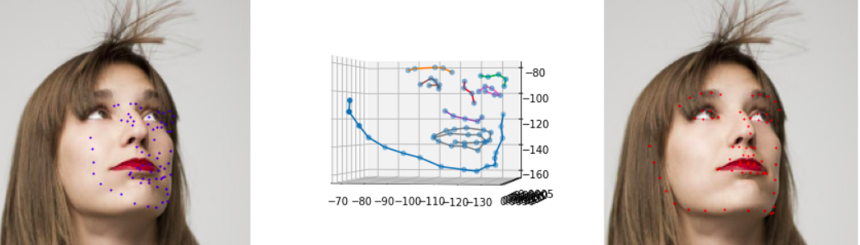
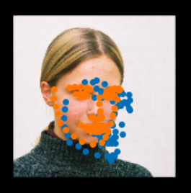
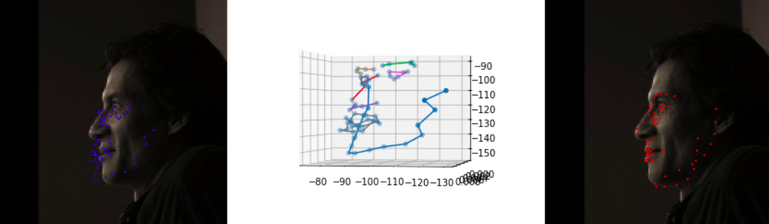
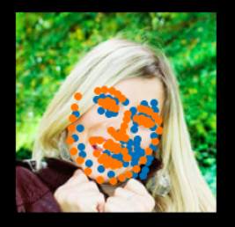
Train: 100% Synthetic
Test: Real
Landmarks - Results

Slide 21
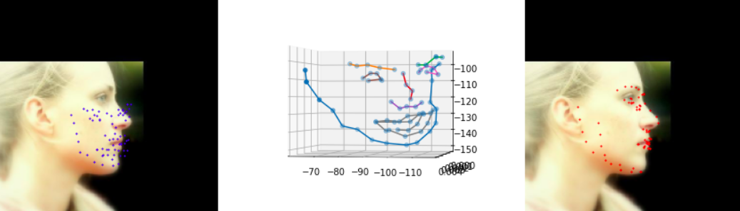
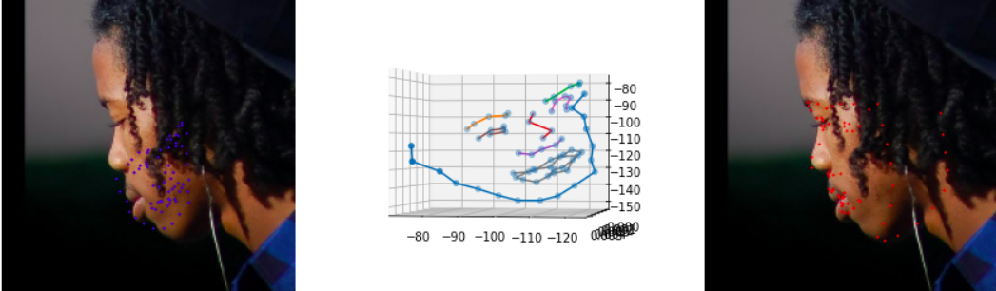
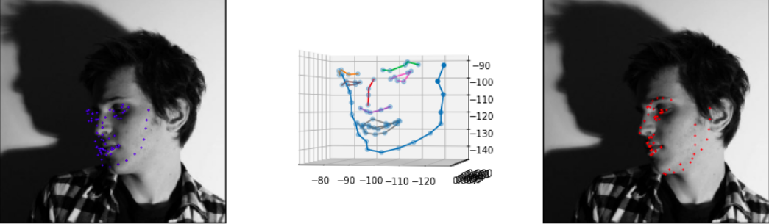
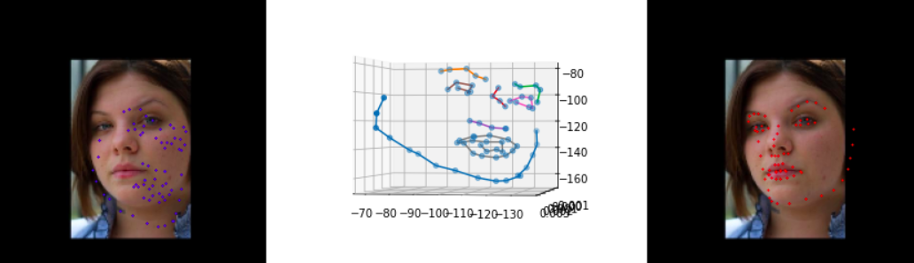
Train: 100% Synthetic
Test: Real
Landmarks - Results

Slide 22
Landmarks
90% Synthetic + 10% Real
4000 synthetic + 100 real images
~150 epochs
batch_size = 4
lr=10e-4 -> 10e-6
Optimizer: Adam, weight decay=0.0005
Trained on Matpool
GPU Name: NVIDIA Tesla K80
Training time: ~7h
Model size: 1.2M

Slide 23
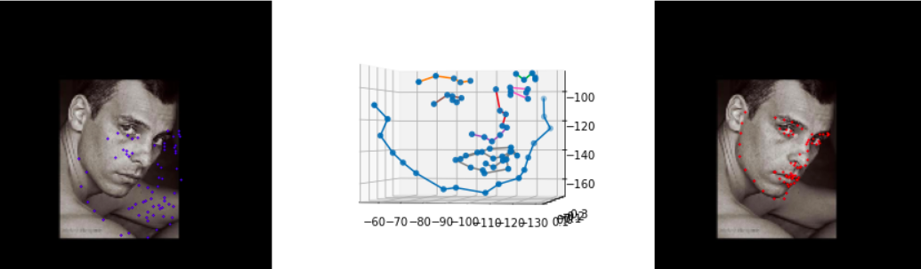
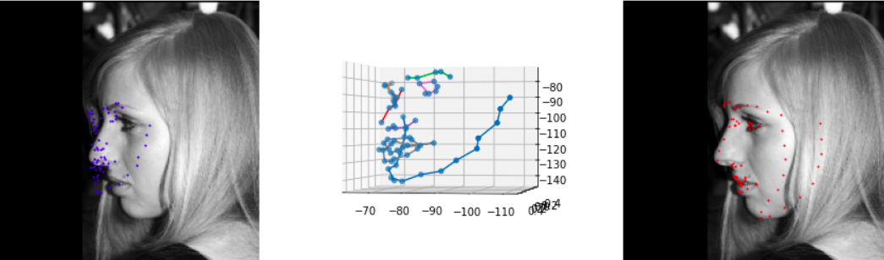
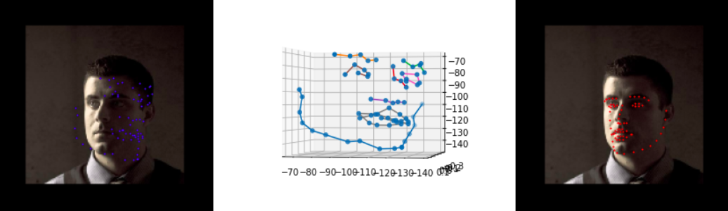
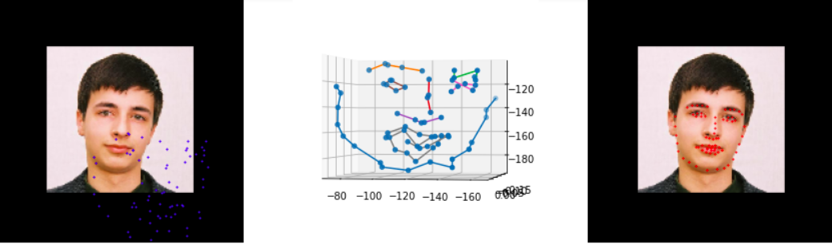
Train: 90% Synthetic + 10% Real
Test: Real
Landmarks - Results

Slide 24
Landmarks
60% Synthetic + 40% Real
4000 synthetic + 2000 real images
~100 epochs
batch_size = 4
lr=10e-4 -> 10e-6
Optimizer: Adam, weight decay=0.0005
Trained on Matpool
GPU Name: NVIDIA Tesla K80
Training time: ~10h
Model size: 1.2M

Slide 25
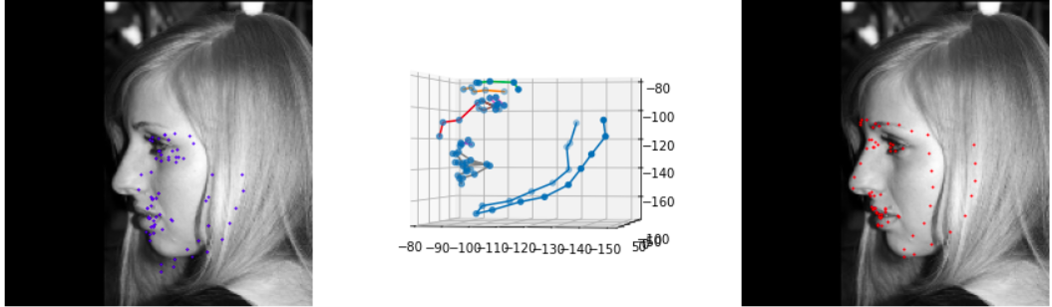
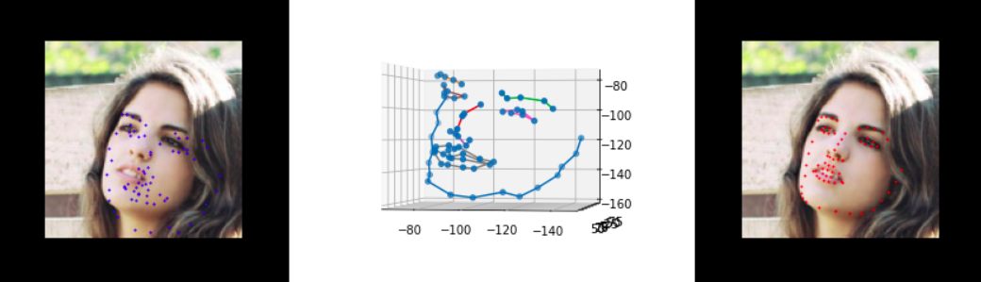
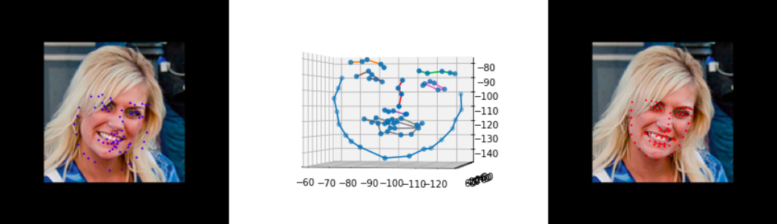
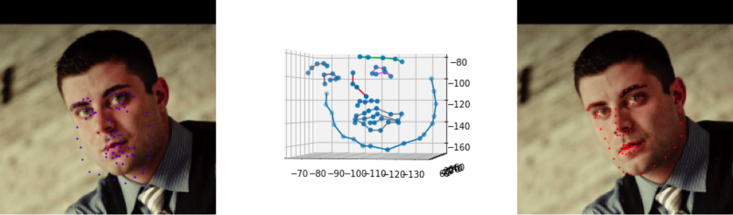
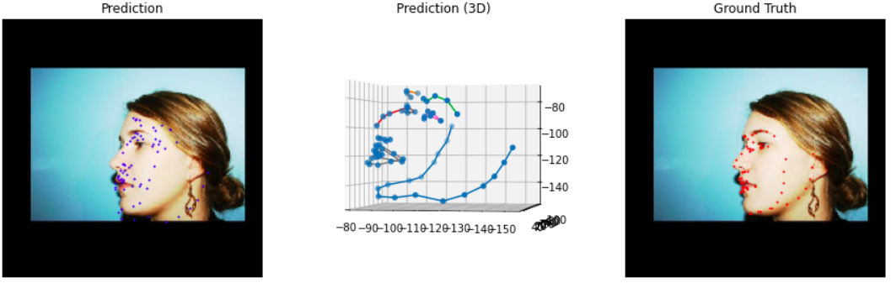
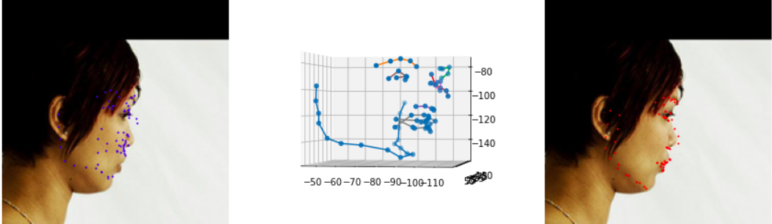
Train: 60% Synthetic + 40% Real
Test: Real
Landmarks - Results

Slide 26
Summary
Training Data | Test | Point-wise Accuracy | General Posture
100% Real | Real | High | Accurate
100% Synthetic |  | Low | Inaccurate
90% Synthetic + 10% Real |  | Low | Inaccurate
60% Synthetic + 40% Real |  | Low | Accurate
Observation:
Conclusion: In facial landmarks detection tasks, synthetic data might be a good way to augment

Slide 27
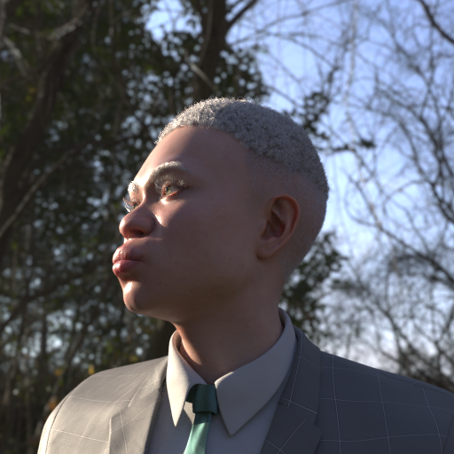
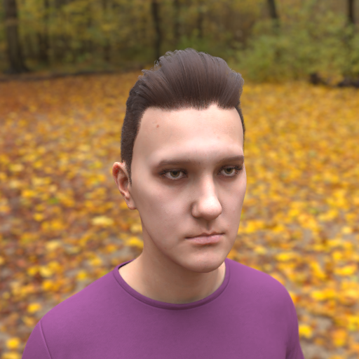
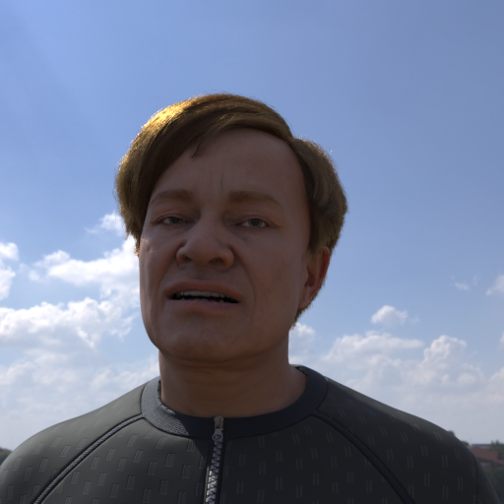



























Discussion
Different distributions of training and test data

Slide 28
Discussion
Results
Lack of quantititive results: logging failure.
Incompatible dataset size and model depth:
< 10,000 images
> 50 layers network

Slide 29


Discussion
How to improve
Data Augmentation
Different Network Structures
MobileNet Backbone
Hourglass
https://arxiv.org/pdf/1711.06753.pdf

Slide 30
Demo
Inference on laptop CPU (Intel Core i7-8550U)
GIF in fig folder

Slide 31
What I learned from this project
Face Detection Module
(Obtain accurate face crop)
Landmarks Prediction Module
(Obtain landmark locations)
2D image
3D coordinates
Data matters, quality and quantity
Definitely should experiment with different network architectures
Do some ablation experiments
Always read before action
Training takes time
Logging is a good habit

